Slide 1

Cancer Diagnosis
Problem type: Classification

Slide 2

Specialized Doctor has very little time to review test results for cancer patients as they are super busy with high demand
The test results generally came in the form of numbers and technical specs
Its hard for anyone to assess whether a patient has malignant cell by looking at numbers
Problem Statement
Diagnose Preliminarily or confirm diagnosis
From the test result

Slide 3
Patient Data
Data Information
Features are computed from a digitized image of a fine needle aspirate (FNA) of a breast mass. They describe characteristics of the cell nuclei present in the image.
n the 3-dimensional space is that described in: [K. P. Bennett and O. L. Mangasarian: "Robust Linear Programming Discrimination of Two Linearly Inseparable Sets", Optimization Methods and Software 1, 1992, 23-34].
This database is also available through the UW CS ftp server:
ftp ftp.cs.wisc.edu

Slide 4

So lets Run with a Robot AI…..

Slide 5
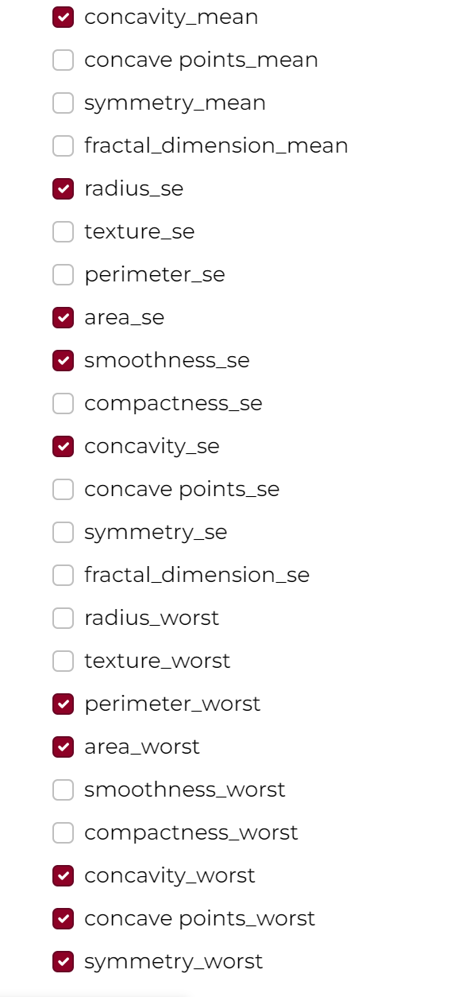
Get the Decision with 4 steps
Login
Under Healthcare Project Create Solution Name “Cancer_Classification”→ Classification → Click create Solution
Data
Build Model
Name your data “Patient History” → upload Cancer_class_train.csv
Select target. Choose “Diagnosis” as your target
A window will pop up asking you run the preliminary analysis or not. Press Yes Button
Preliminary analysis will run-→see result in Confusion Matrix and Prediction KPI for error
Press Next→ land in “build Model page
Train multiple times to select common variable from feature importance for each run
Select Variables
Based on feature importance
Select Algorithm
Random Forest
XGBoost
Click on Train
Click on Finalize
You will land on Deploy page

Slide 6
Get the Decisions with 4 steps
Deploy
Decision
Click on Add data→
upload new data from CSV source from you computer Cancer_class_Pred.csv file
A variable list will show up→ click on skip
Go to Data Post Process
Create Action if Malignant probability < .7 “Double Check”
IF benign probability more than 0.4, double check
Go to Result Configuration
Check download as CSV
Select Algorithm
Press “Predict”, prediction will running
Press Next→ you will land in Decision Page
Select Decision Scenario Tab
Change slider value for different variables
Press Apply
Do the step until Target or Target desired value is higher or lower or middle

Slide 7


